Slide 1
Heart Attack Risk Prediction using Machine Learning
Group-16
Akhil Rayapati
Hemanth Anumolu
Mahesh Hasbi
Prashanth Sammanu
Saandeep Ippagunta

Slide 2
Introduction
Predictive Healthcare: In the realm of predictive healthcare, our project endeavours to harness the power of machine learning to foresee heart attack risks, providing stance for cardiovascular health management.
Proactive Cardiovascular Health: As our world becomes increasingly digital, the confluence of medical data and advanced analytics offers unprecedented opportunities for early detection and prevention.
Project Overview:
Holistic Approach: Our venture encompasses a holistic approach from data preprocessing to model optimization, with a dedicated focus on predicting heart attack risks.
Leveraging the Heart Attack Prediction Dataset from Kaggle, our aim is to create a robust end-to-end pipeline utilizing cutting-edge machine learning techniques.

Slide 3
Dataset and AWS Tools Utilization
Brief Introduction to the Dataset:
Heart Attack Prediction Dataset from Kaggle.
Goal: Unravel patterns for accurate predictions, enabling proactive cardiovascular risk mitigation.
Utilization of AWS Tools and Pipeline:
Seamless Integration: Amazon S3 for data storage.
Dynamic Querying: Amazon Athena.
Comprehensive Visualization: Amazon QuickSight.
End-to-End Pipeline: AWS Glue for ETL. SageMaker for model development, Lambda for automation

Slide 4
End-to-End Pipeline on AWS
Overview:
Seamless Workflow: From data preprocessing to model deployment.
AWS Integration: Leveraging a variety of AWS services for a comprehensive end-to-end pipeline.
Key Stages:
Data Preprocessing: Utilizing AWS Glue for efficient ETL processes, ensuring data readiness for analysis and model development.
Exploratory Data Analysis (EDA): Leveraging AWS services like Athen for dynamic querying, gaining insights into data patterns and correlations.
Model Training and Evaluation: Harnessing the power of Amazon SageMaker for advanced model development, Iterating training and evaluation cycles to enhance predictive accuracy.
Optimization: Continuous refinement based on evaluation results, ensuring model adapts to diverse datasets.
Deployment: Seamless deployment using AWS Lambda, ensuring scalability and efficiency in real-time prediction.

Slide 5
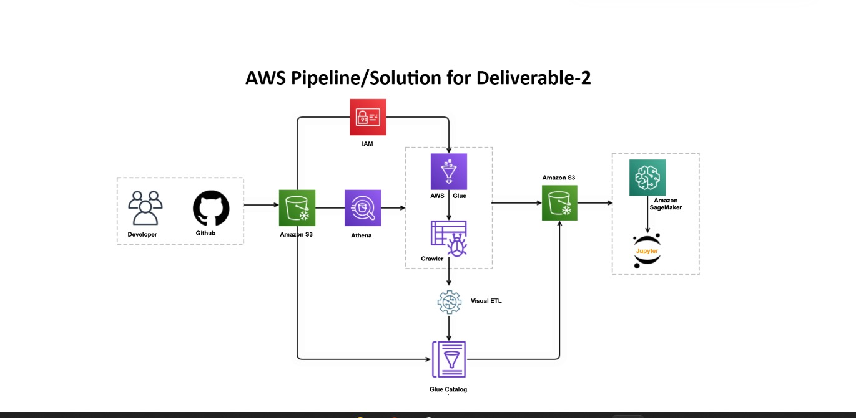
Pipeline

Slide 6
AWS Services Used
AWS Cloud9 - Creating an integrated development environment and configuring IAM roles for necessary permissions.
Amazon S3 and S3 Select- Utilizing S3 Select for running SQL queries against a single file and understanding the structure of the dataset.
Amazon Athena - Using Athena to query data stored in multiple files.
AWS Glue - Configuring AWS Glue for crawling data and inferring its structure, updating metadata using crawler and adding new data.
Amazon SageMaker - Enabling advanced model development, facilitating the iterative training and evaluation of the predictive model.
AWS Lambda – Automating pipeline processes for enabling efficiency, optional integration for seamless, hand-free operation.
AWS Cost Explorer and Trusted Advisor - Monitoring and optimizing costs throughout the project lifecycle, ensuring cost-effectiveness without compromising on performance.
Amazon QuickSight - Setting up QuickSight for data visualizations and creating charts and modifying queries in QuickSight.

Slide 7
Lessons learned
Importance of IAM roles for secure access.
Utilizing various AWS services for different stages of data preprocessing and analysis.
Hands-on experience with the data transformations using Pandas, querying with Athena and visualizations with QuickSight.

